Slide 1

Optimizing Retail Profitability Through Data-Driven Inventory & Sales Management
A comprehensive analysis to identify opportunities for improved pricing, vendor management, and inventory efficiency.

Slide 2
Critical Questions Driving Our Analysis
01
02
03
Underperforming Brands
Vendor Performance
Bulk Purchasing Impact
Which brands need promotional or pricing adjustments to boost sales?
Who are our top vendors contributing to sales and gross profit?
How does bulk buying affect our unit costs and profitability?
04
05
Inventory Efficiency
Profitability Variance
Where can we improve turnover to reduce holding costs?
What drives profit differences between high and low performers?

Slide 3

Key Findings from Summary Statistics
Warning Signs Detected
Opportunity Areas
Negative Gross Profit
Premium Products
Minimum of -$52,002.78 indicates losses from discounts or selling below cost.
Max prices of $7,499.99 vs. mean of $35.64 indicate high-value offerings.
Zero Sales Products
Stock Turnover Variance
Purchased inventory never sold suggests slow-moving or obsolete stock.
Range of 0 to 274.5 shows some products sell rapidly while others stagnate.
Extreme Freight Costs
Data Cleanup
Range from $0.09 to $257,032.07 reveals logistics inefficiencies.
Removed transactions with zero profit margins and unsold inventory for accuracy.

Slide 4

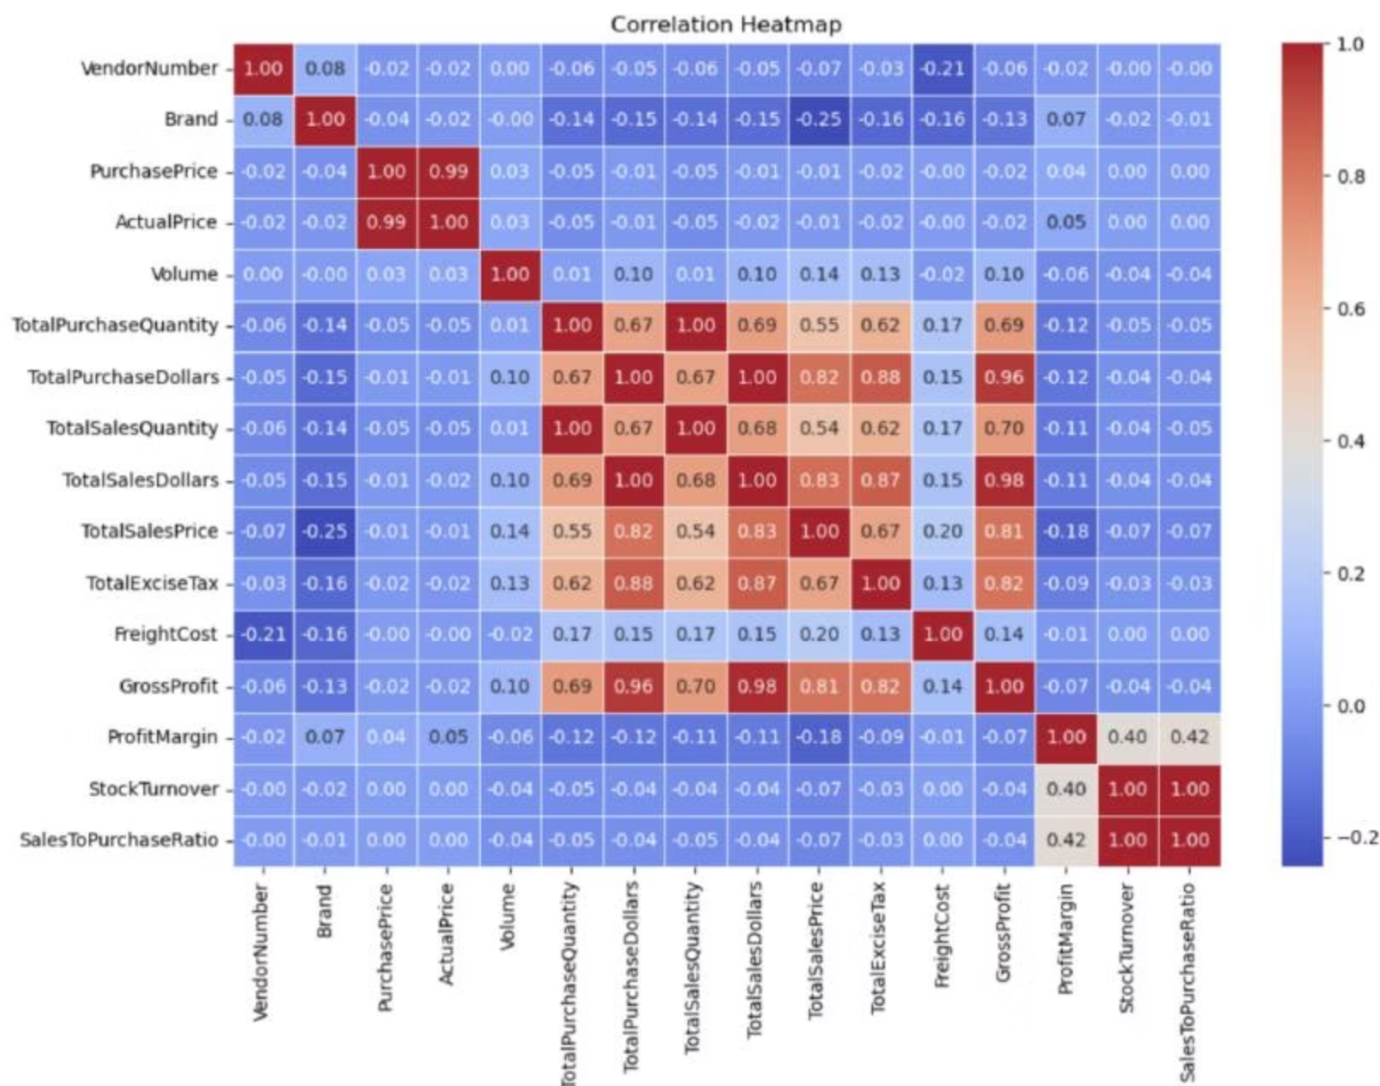
Correlation Analysis Reveals Market Dynamics
Price vs. Revenue
Weak correlation (-0.012) shows price variations don't significantly impact sales or profit.
Efficient Inventory
Strong correlation (0.999) between purchase and sales quantities confirms excellent turnover.
Pricing Pressure
Negative correlation (-0.179) suggests higher prices may reduce margins due to competition.
Turnover Paradox
Faster stock turnover (-0.038) doesn't guarantee higher profitability.

Slide 5
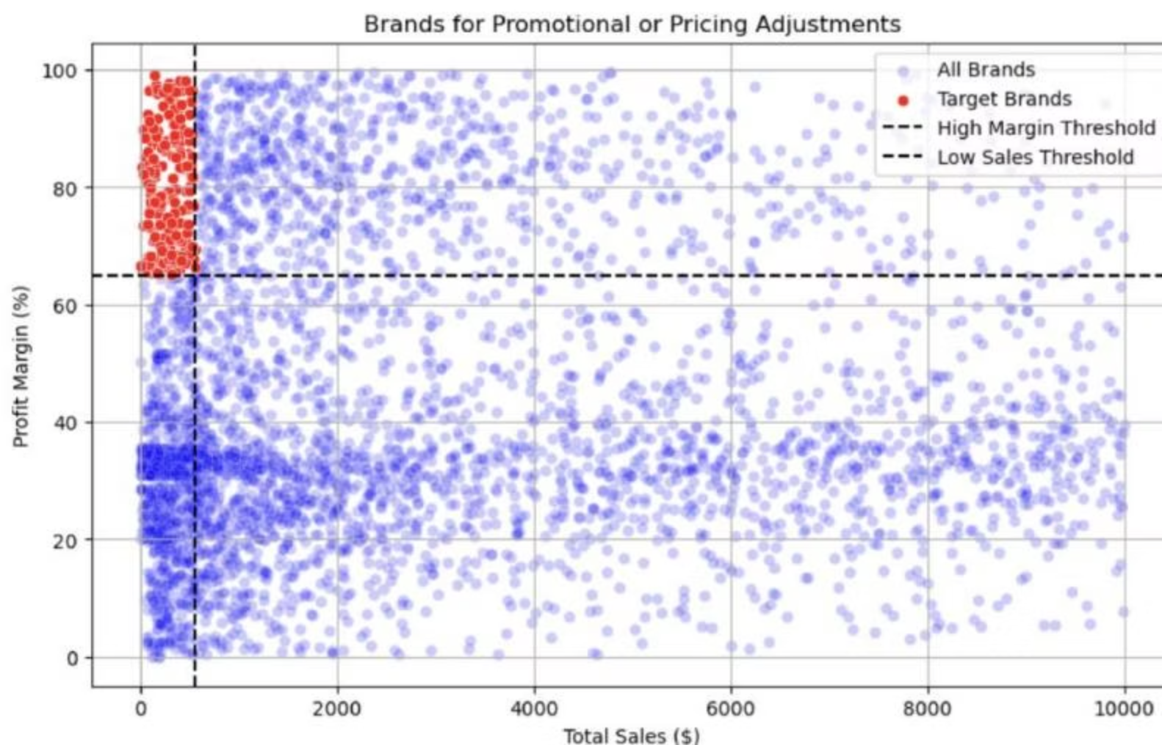
198 Brands Ready for Promotional Boost
High-margin, low-sales brands concentrated in the top-left quadrant show profit margins above 60% but sales below $1,000.
These brands could benefit from targeted marketing, promotions, or price optimizations to increase volume without compromising profitability.
Strategy: Launch promotional campaigns to convert high margins into higher sales volumes.

Slide 6

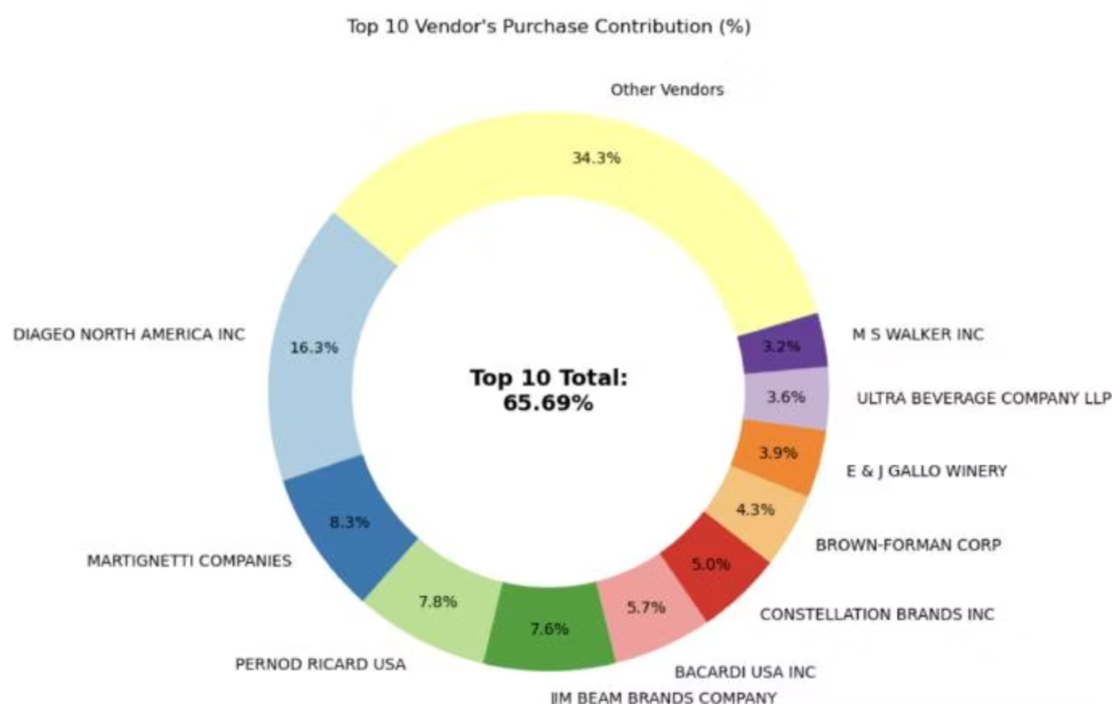

Vendor Concentration Risk
65.69%
34.31%
Top 10 Vendors
Remaining Vendors
Contribute nearly two-thirds of total purchases
All other vendors combined contribute only one-third
Risk Alert: Over-reliance on few vendors may introduce supply chain disruptions. Diversification is essential to mitigate risks.

Slide 7

Bulk Purchasing Drives Major Cost Savings
The Bulk Advantage
Vendors purchasing in large quantities receive $10.78 per unit compared to significantly higher costs in smaller orders.
72%
Bulk pricing strategies encourage larger orders
Increases total sales volume
Maintains strong profitability margins
Recommendation: Incentivize bulk purchasing across more vendor relationships.
Cost Reduction
Lower unit cost achieved through bulk orders

Slide 8




Slow-Moving Inventory Drains Capital
$2.71M
Total capital locked in unsold inventory
Increased Storage Costs
Holding unsold products raises warehousing expenses
Reduced Cash Flow
Capital tied up in inventory limits operational flexibility
Profitability Impact
Low turnover directly affects overall financial performance

Slide 9
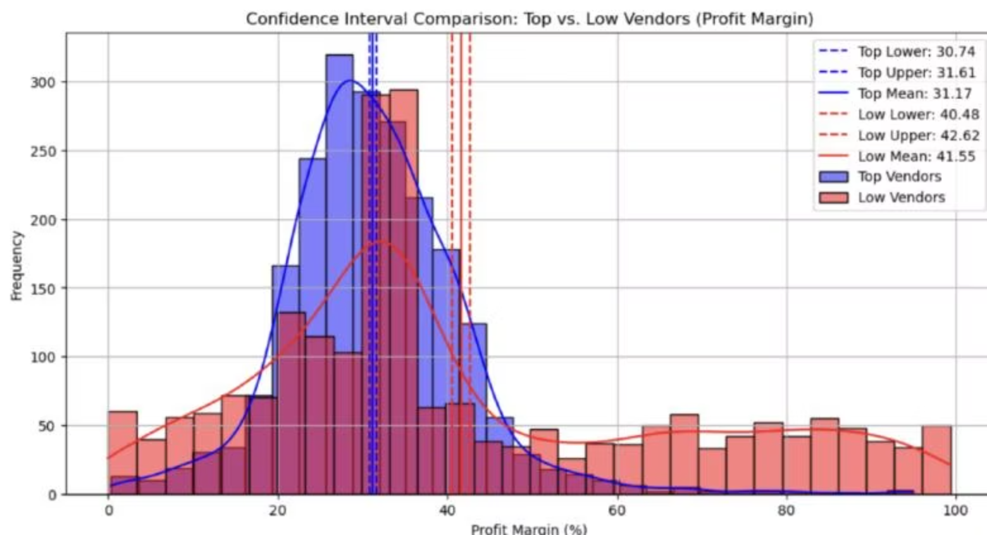
Profit Margin Analysis: A Tale of Two Strategies
Top Performers
31.17%
Mean Profit Margin
95% CI: 30.74% - 31.61%
High sales volume with moderate margins. Focus on efficiency and scale.
Low Performers
41.55%
Mean Profit Margin
95% CI: 40.48% - 42.62%
Higher margins but lower volumes. Pricing inefficiencies or limited market reach.
Statistical Validation: Hypothesis testing confirms significant differences between groups, indicating distinct profitability models requiring tailored strategies.

Slide 10
Strategic Recommendations for Sustainable Growth
Optimize Pricing
Diversify Vendors
Leverage Bulk Buying
Re-evaluate pricing for 198 low-sales, high-margin brands to boost volume without sacrificing profitability.
Reduce dependency on top 10 vendors (65.69% concentration) to mitigate supply chain risks.
Expand bulk purchasing programs to achieve 72% cost savings across more vendor relationships.
Clear Slow Inventory
Boost Marketing
Address $2.71M in unsold stock through adjusted purchasing, clearance sales, or revised storage strategies.
Enhance distribution and marketing for low-performing vendors to drive sales without compromising margins.
By implementing these data-driven recommendations, the company can achieve sustainable profitability, mitigate risks, and enhance overall operational efficiency.

